Slide 1
Recurrences

Slide 2
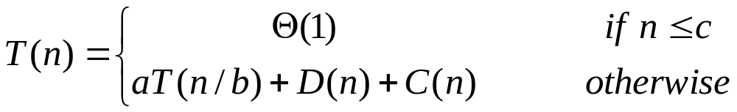
Recurrence Equation

Slide 3
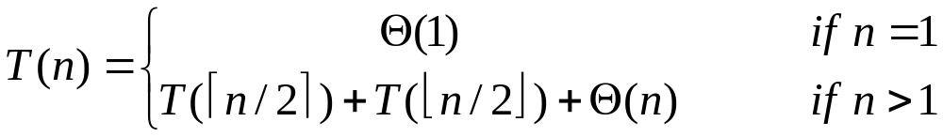

Technicalities
  Ignoring the assumption of integer arguments to function
  Ignoring boundary conditions
Merge-Sort
  After Ignoring 1& 2

Slide 4
Solving Recurrences
  Substitution Method
  Recursion-tree Method
  Master Method

Slide 5
Substitution Method
  Guess the solution
  Use Mathematical induction to show that the solution works.
Examples:
  T(n) = 2T(⎣n/2⎦)+n
  T(n) = T(⎣n/2⎦)+T(⎡n/2⎤)+1

Slide 6
The Recursion-Tree Method
  Each node represents the cost of a single sub-problem
  Summing the cost within each level of the tree give a per-level costs
  Summing the pre-level cost gives the total costs of the recurrence.
Examples:
  T(n) = 3T(n/4)+cn²
  T(n) = T(n/3)+T(2n/3)+O(n)

Slide 7
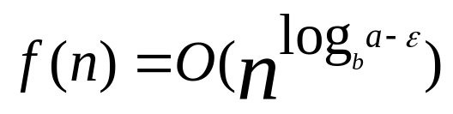
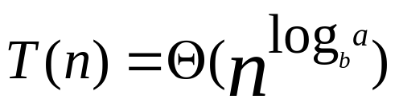
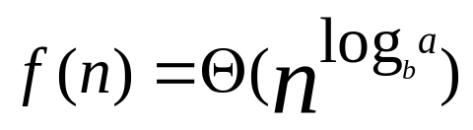
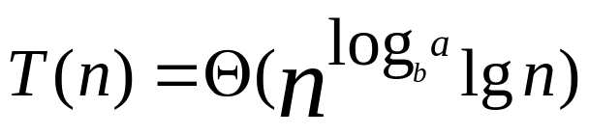
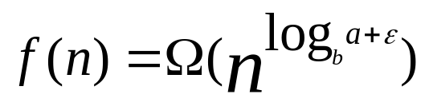
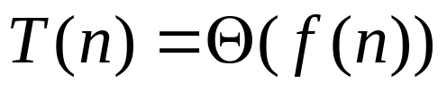
3. Master Method
  Solve the recurrence of the form:
    T(n)= a T(n/b) + f(n) ,
    Where: a ≥ 1, b > 1, f(n) asymptotically +ve function.
  If , ε > 0, then:
  If , then:
  If , ε > 0, and if
    af(n/b) ≤ cf(n) for c < 1, then:

Slide 8
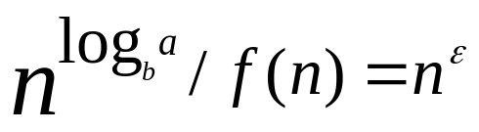
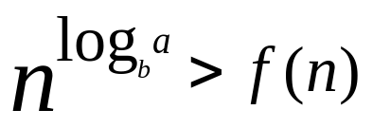

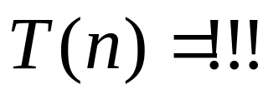
Case 1:
If , ε > 0, then:
If then:
If and
then:

Slide 9
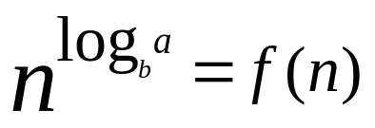
Case 2:
If ,then:
If then:

Slide 10

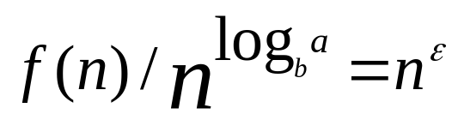

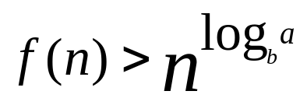
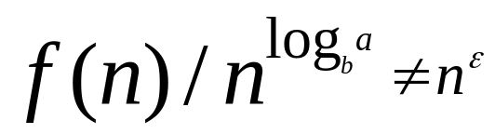
Case 3:
If , ε > 0, and if
    af(n/b) ≤ cf(n) for c < 1, then:
If and
then:
If and
then:

Slide 11
Examples:
  T(n) = 9T(n/3)+n
  T(n) = T(2n/3)+1
  T(n) = 4T(n/2)+n³
  T(n) = 2T(n/2)+n lg n

